Slide 1
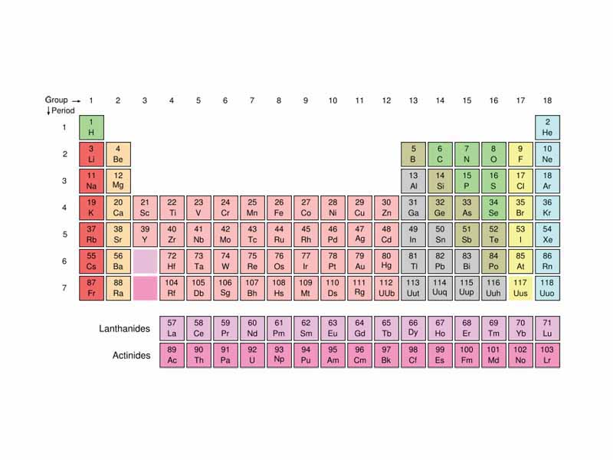
Ch. 6: The Periodic Table of Elements

Slide 2
Essential Questions
What information does the Periodic Table provide about atoms?
Why are the elements arranged in the way that they are?
What are the trends of the elements of the PTE?

Slide 3
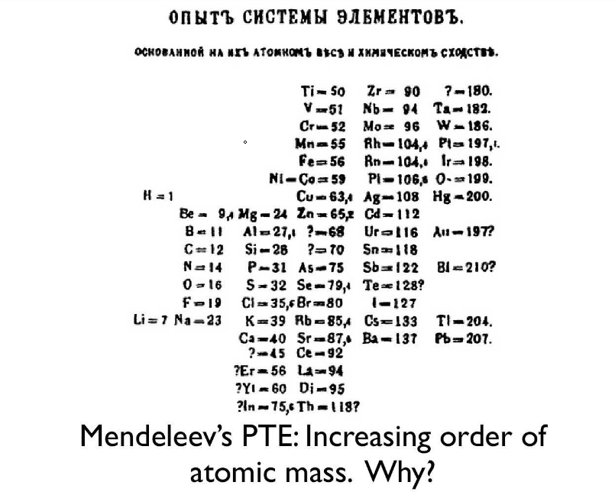
Mendeleev’s PTE

Slide 4
Periodic Law
Elements are arranged in order of increasing atomic number.
There is a periodic repetition of physical and chemical properties.

Slide 5
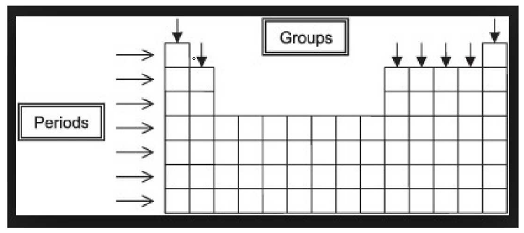
Periods and Groups

Slide 6
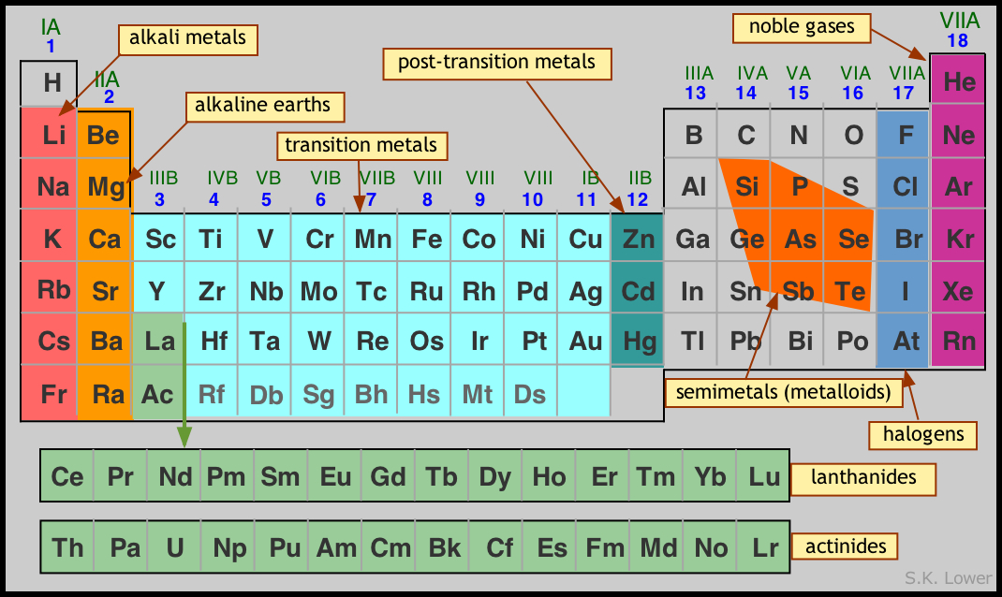
Groups of the PTE

Slide 7

Quick Element

Slide 8
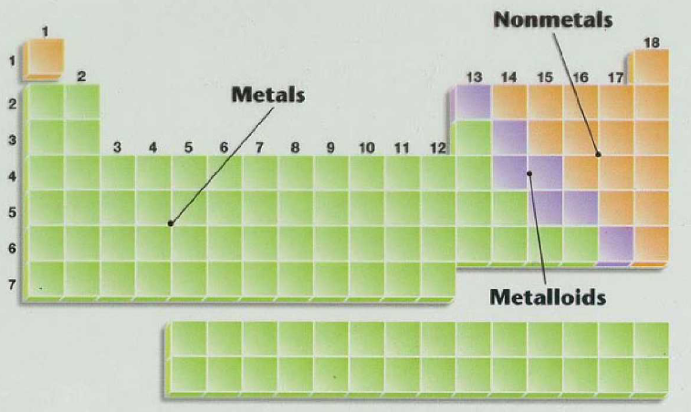
Metals, Non-Metals & Metalloids

